Slide 1
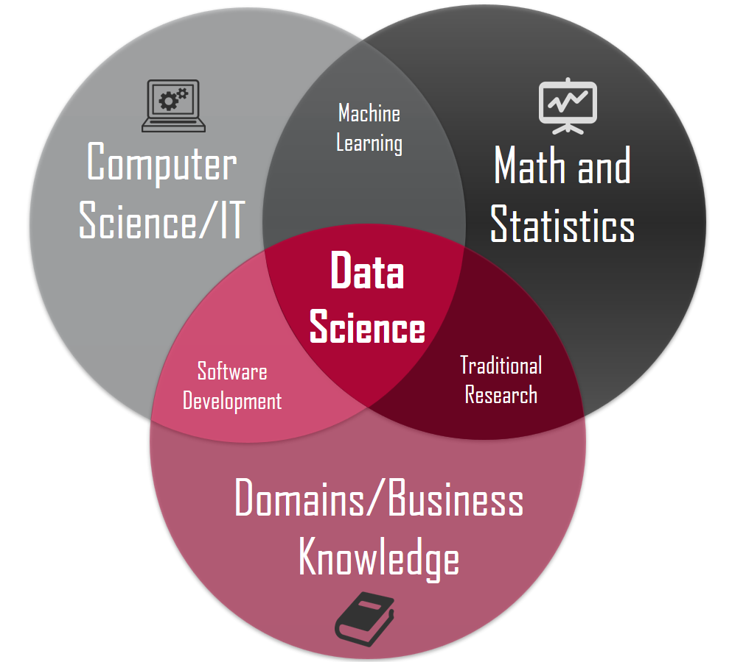
Introduction to Data Science

Slide 2
What is Data Science
Data science means gathering data,
Finding patterns in data.
Taking decision.
Eg :
  Let us take an example to covid, initially we were not able to predict the decease.
  Later we collected data like symptoms, causes.
  Then with that data and pattern , we were able to come to a conclusion that
  it was covid.

Slide 3
Continue..
Can anyone give me one such example ?
Some examples :
  For route planning: To discover the best routes to ship
  To create promotional offers
  To find the best suited time to deliver goods
  To predict who will win elections
Data Science can be applied in nearly every part of a business where data is available

Slide 4
How Does a Data Scientist Work?
A Data Scientist requires expertise in several backgrounds:
Machine Learning
Statistics
Programming (Python or R)
Mathematics
Databases

Slide 5
What is Analytics?
Analytics is the process of discovering, interpreting, and communicating significant patterns in data.
Quite simply, analytics helps us see insights and meaningful data that we might not otherwise detect.

Slide 6
Business analytics
Business analytics focuses on using insights derived from data to make more informed decisions that will help organizations increase sales, reduce costs, and make other business improvements.
Business analytics is ubiquitous these days because every company wants to perform better and will analyze data to make better decisions. Organizations are looking to get more from analytics

Slide 7
Data Analytics
Data analytics is the science of analyzing raw data to make conclusions about that information.
The techniques and processes of data analytics have been automated into mechanical processes and algorithms that work over raw data for human consumption.
Data analytics helps a business to optimize its performance.

Slide 8
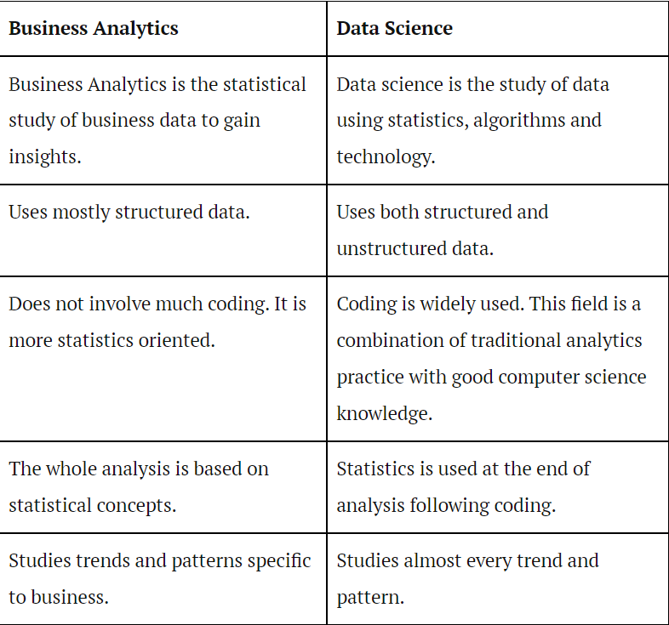

Slide 9
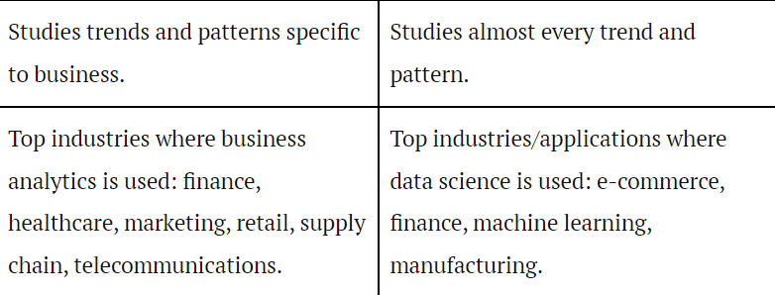

Slide 10
Common Terms in Data Analytics
1. Actions
  An action is any activity a user takes when interacting with your website, application or product. This could include email signups, page views, downloads, video plays, purchases or any other activity that you would like to track.
Bounce Rate
  Your bounce rate is the percentage of people who come to your landing page and leave without browsing further or clicking elsewhere on your website.

Slide 11
Cookies
  The term Cookie also refers to a small file that is stored on a user’s browser or computer when they visit a website.
Direct Traffic
  Anyone who has come to your site by typing your domain name in their browser or used a saved bookmark to access your site will be attributed to direct traffic.

Slide 12
Data warehouse
A data warehouse is a type of data management system that is designed to enable and support business intelligence (BI) activities, especially analytics.
Data warehouses are solely intended to perform queries and analysis and often contain large amounts of historical data.
But as the time passes this data becomes invalid.

Slide 13
OLAP
Online Analytical Processing Server (OLAP) is based on the multidimensional data model.
It allows managers, and analysts to get an insight of the information through fast, consistent, and interactive access to information.

Slide 14
MIS - Management Information System
MIS Reports are reports required by the management to assess the performance of the organization and allow for faster decision-making.

Slide 15
Structured, Unstructured and Semi Structured
Structured data is generally tabular data that is represented by columns and rows in a database.
Databases that hold tables in this form are called relational databases.

Slide 16
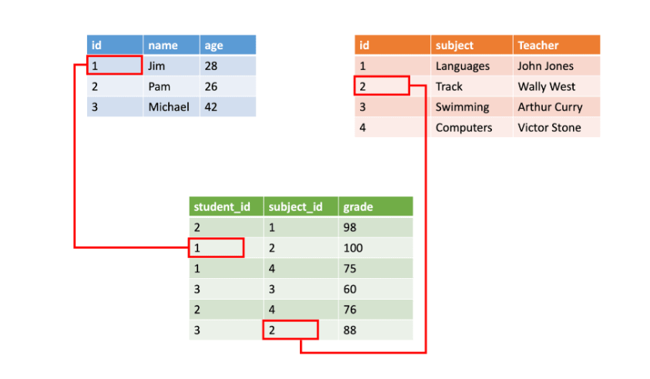
Structured

Slide 17
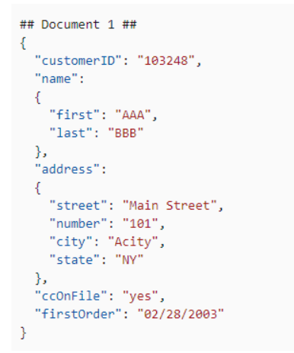
Semi-structured
Semi-structured data is information that doesn’t consist of Structured data (relational database) but still has some structure to it.

Slide 18
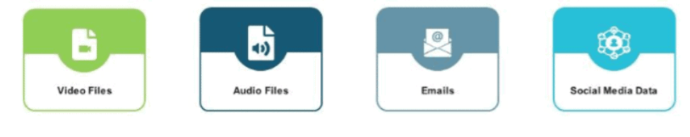
Unstructured Data
Unstructured information is a set of text-heavy but may contain data such as numbers, dates, and facts as well.
Videos, audio, and binary data files might not have a specific structure. They’re assigned to as unstructured data.

Slide 19
Overview of analytics tools & their popularity
R Programming
Tableau Public:
Python
SAS
Excel

Slide 20
Stages of Analytics
THERE ARE 5 STAGES :
DATA MINING
  Data sets exist across many different types of mediums, and data mining is the process of obtaining this information from a large amount of raw data, through different open data sets.
DATA CLEANING
  Data cleaning is the process of data scientists either manually or programmatically reformatting this data into the most economical way for it to be able to be interpreted.
DESCRIPTIVE STATISTICS
  This step gives you preliminary information, without further investigation.

Slide 21
continue
PREDICTIVE ANALYSIS
  Now that the data has been collected and formatted into a useable state, predictive analysis can take place.
  This is the process of using a form of advanced analytic techniques to forecast the likely next step.
prescriptive ANALYSIS
  With the results gained from the predictive analysis, marketers, along with the businesses they represent, are able to use the prescriptive analytics step to formulate a plan of attack when making business plans, backed by the assuredness of a comprehensive data examination.

